Slide 1

Single Cell RNA-seq Analysis
in Human Parkinson’s Disease
Mohsen Nabian, Ph.D.
Postdoctoral Research Fellow

Slide 2
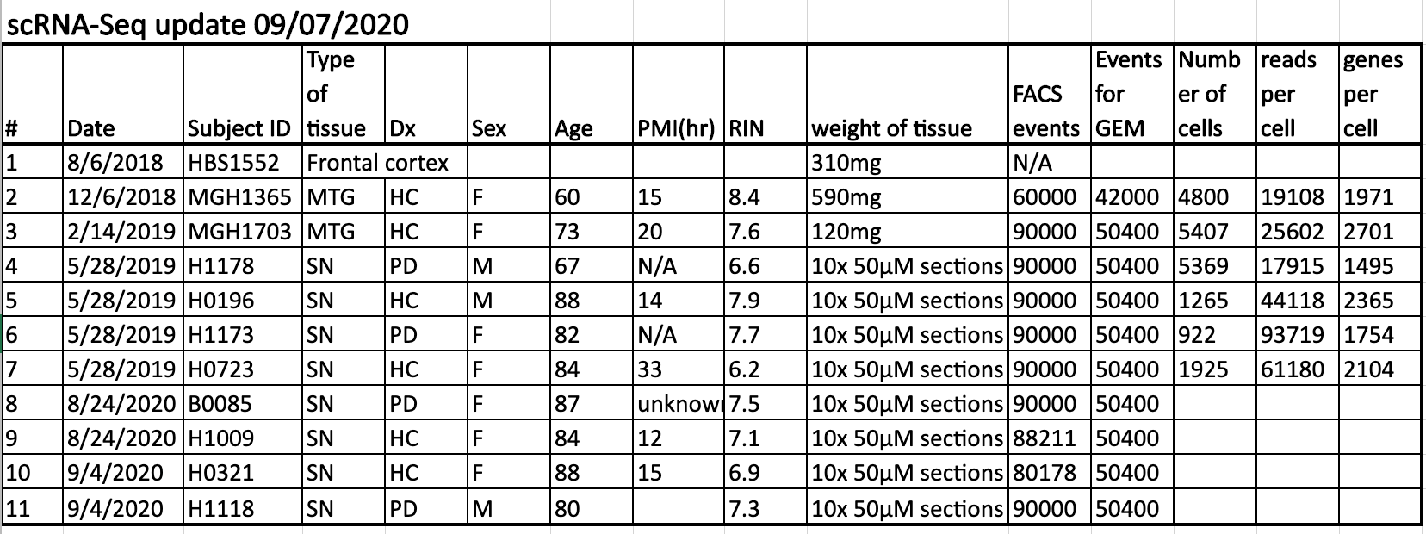
Samples Summary Information

Slide 3
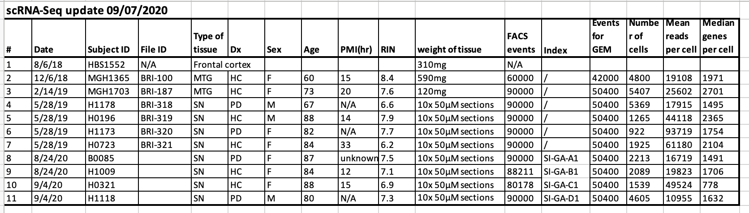

Slide 4
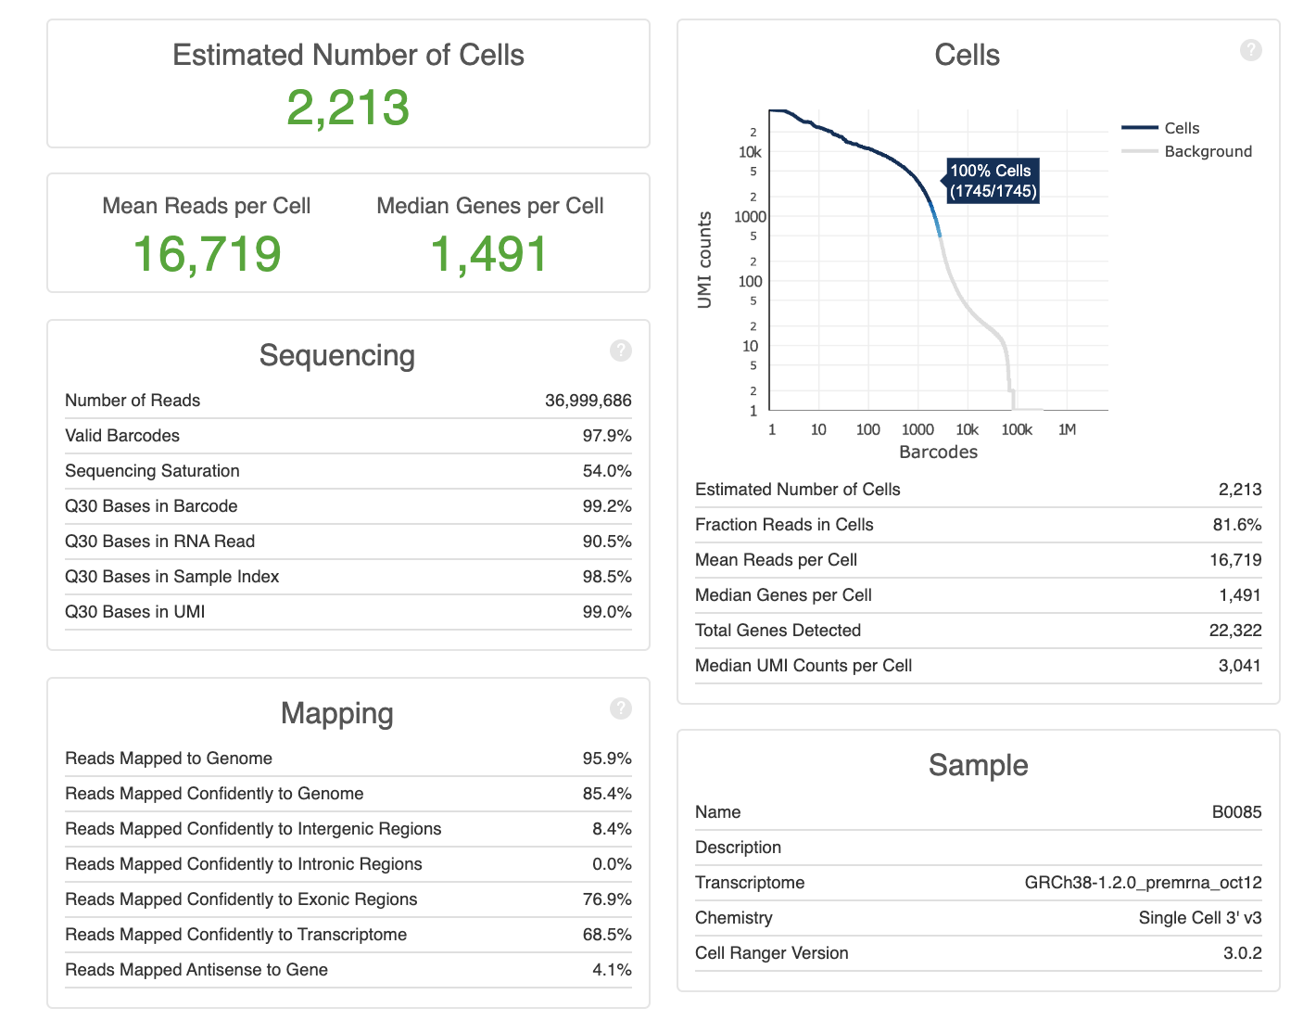
B0085

Slide 5
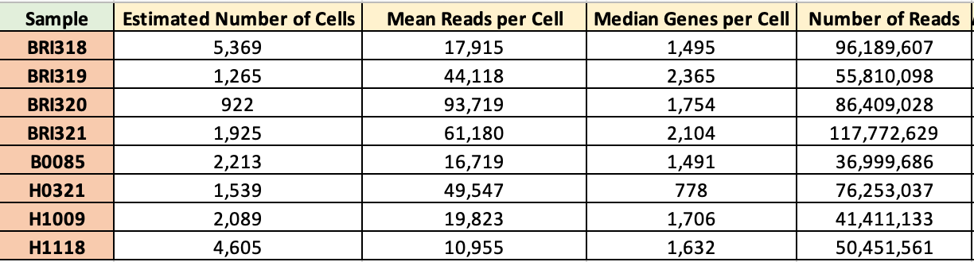
After-Cellranger Analysis Summary

Slide 6
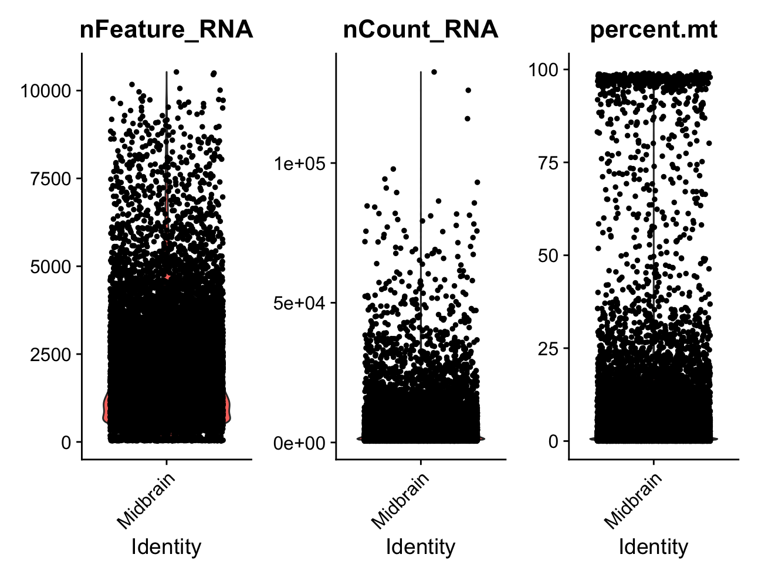

Slide 7
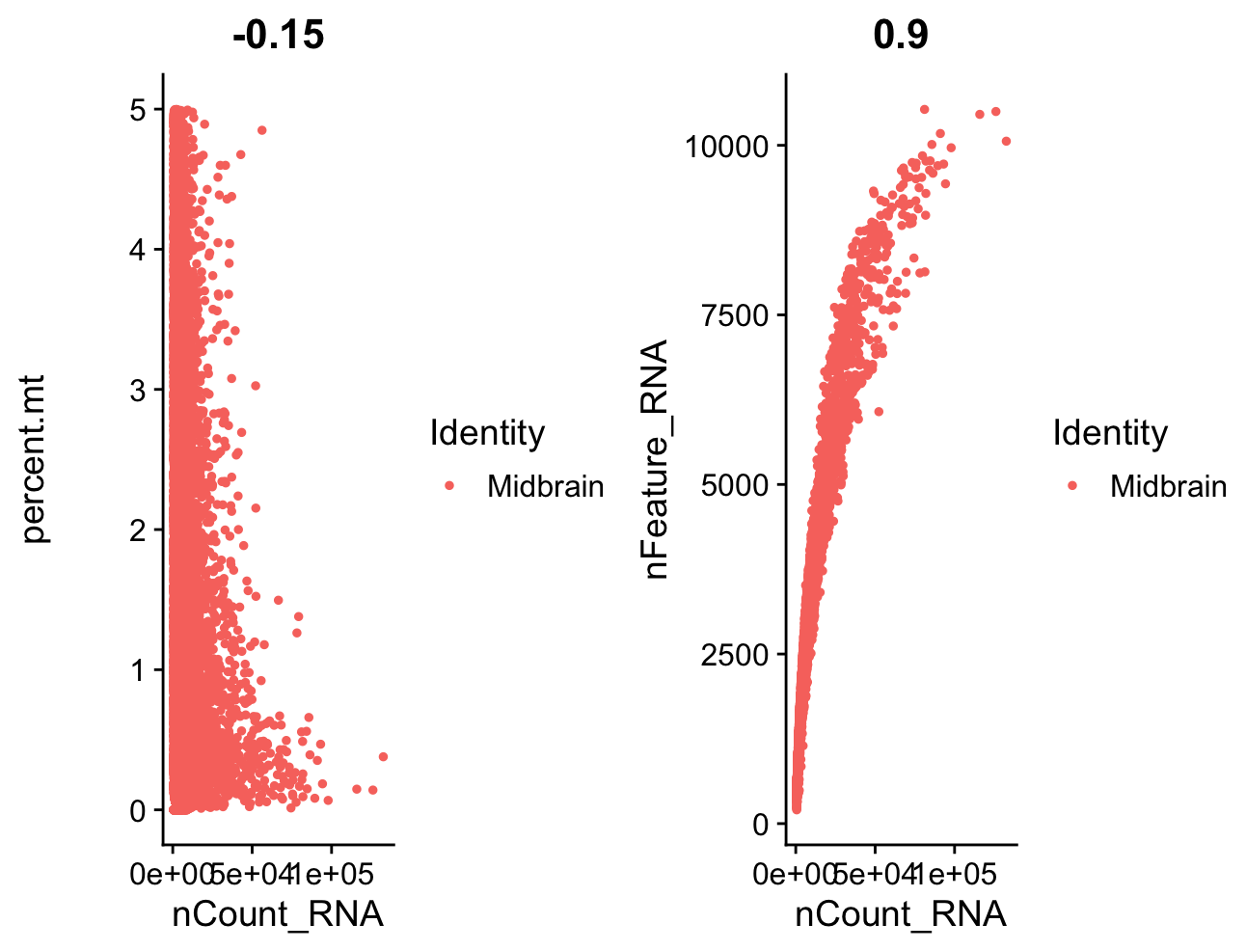

Slide 8
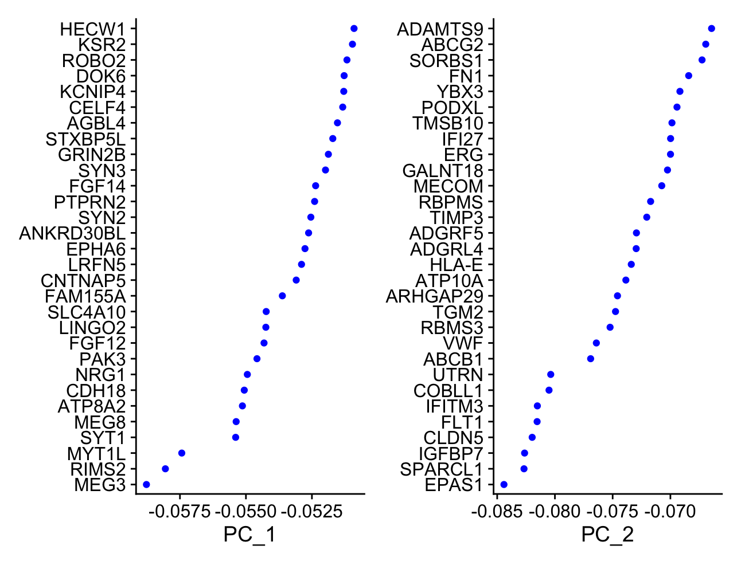

Slide 9
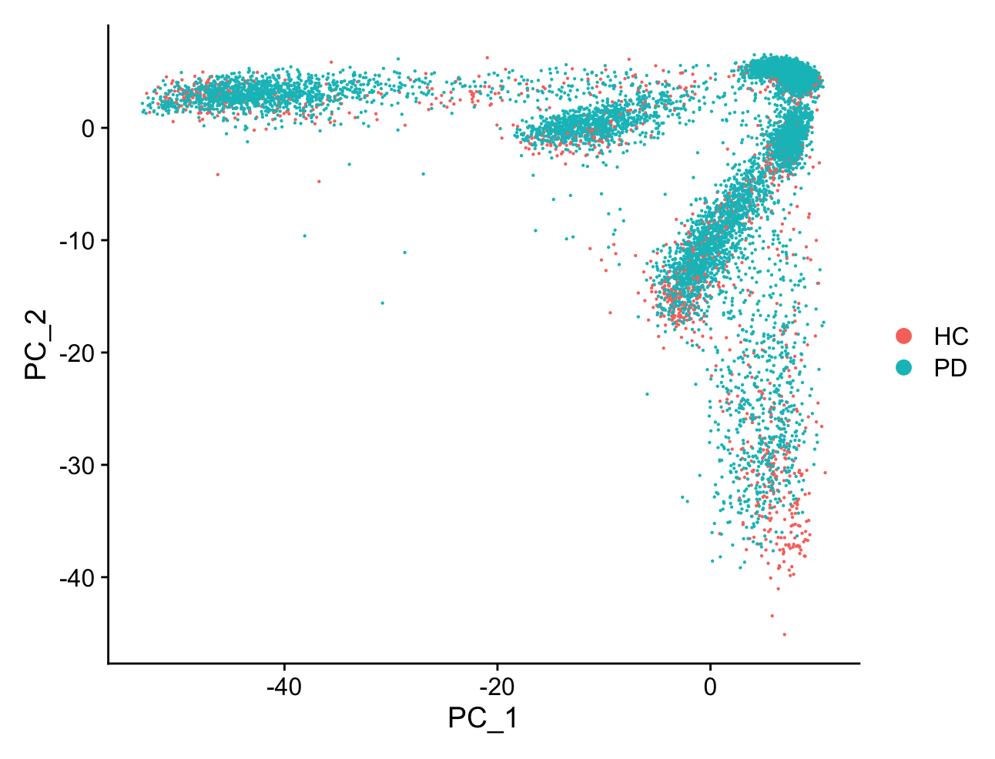

Slide 10
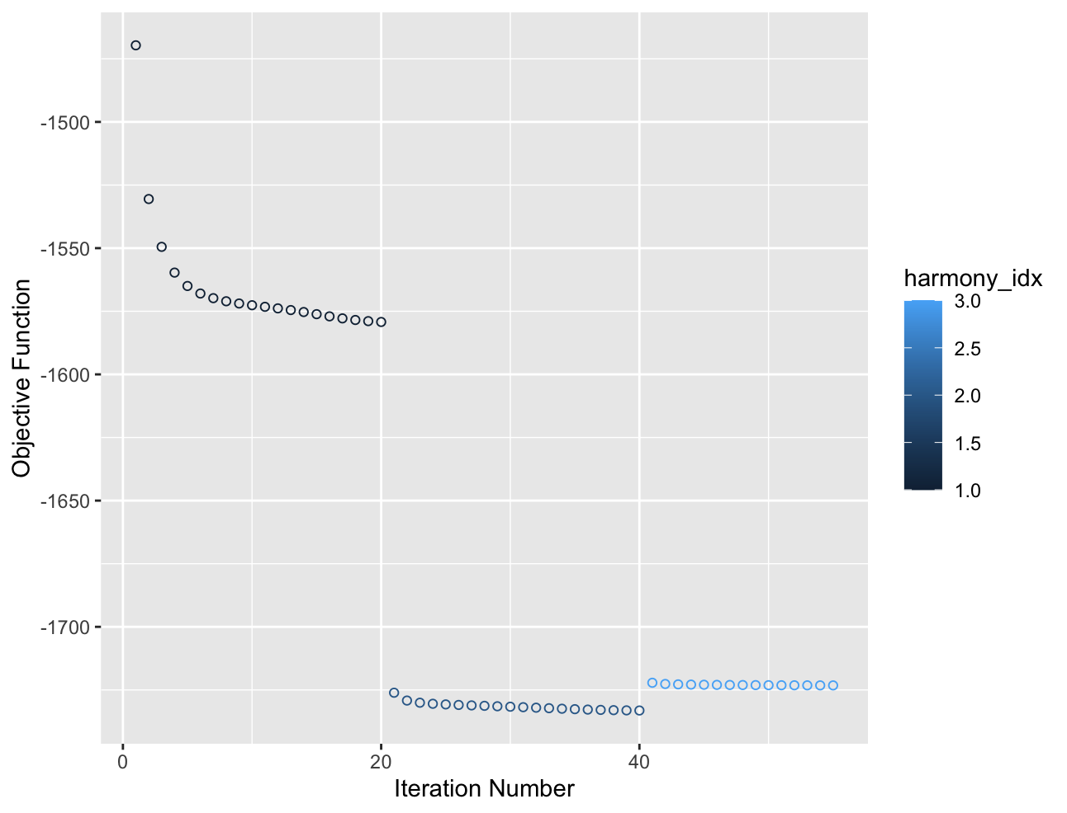

Slide 11
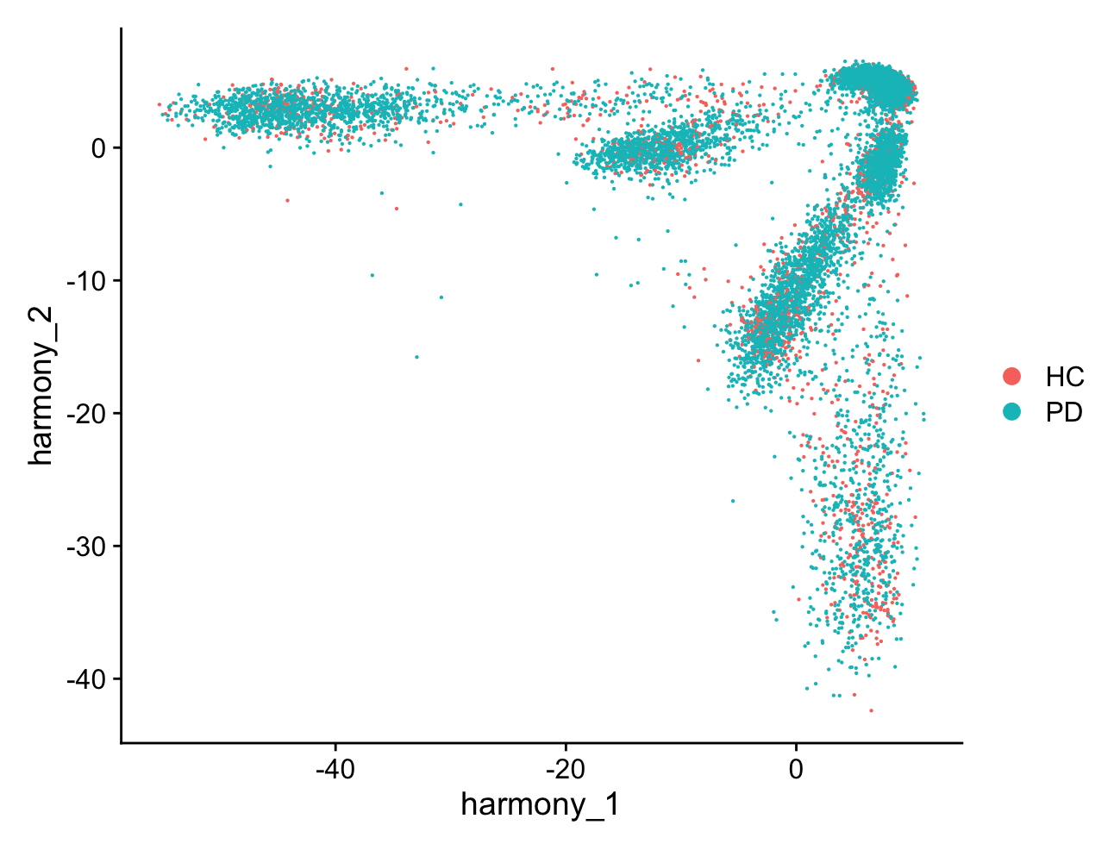

Slide 12
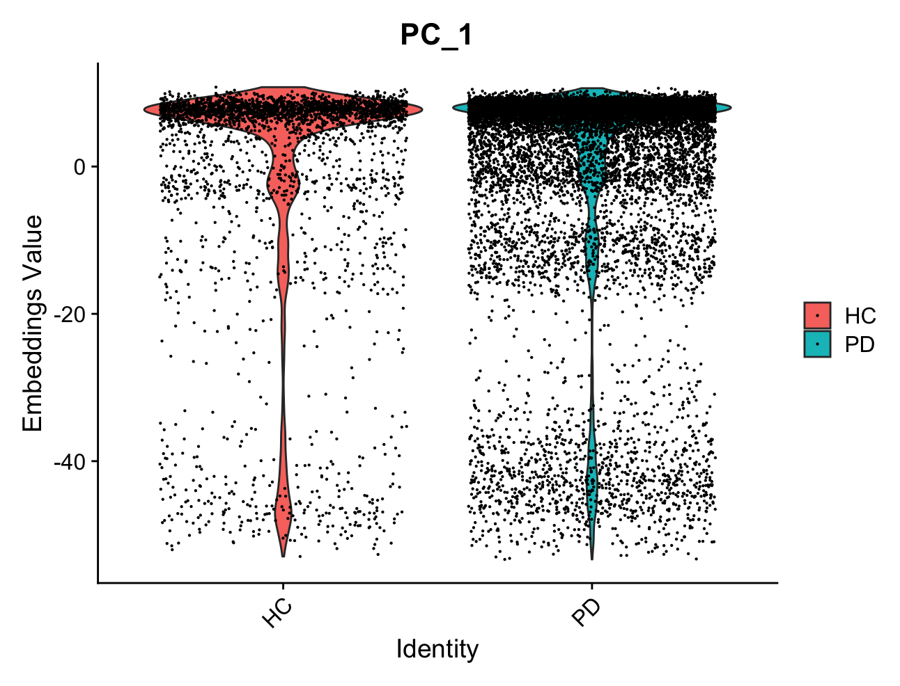

Slide 13
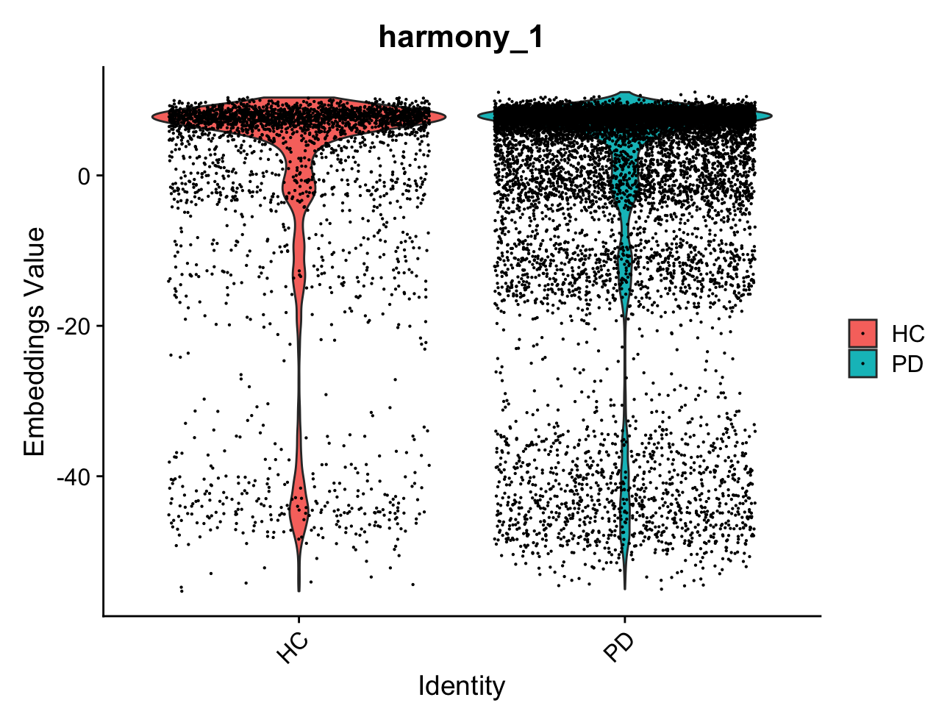

Slide 14
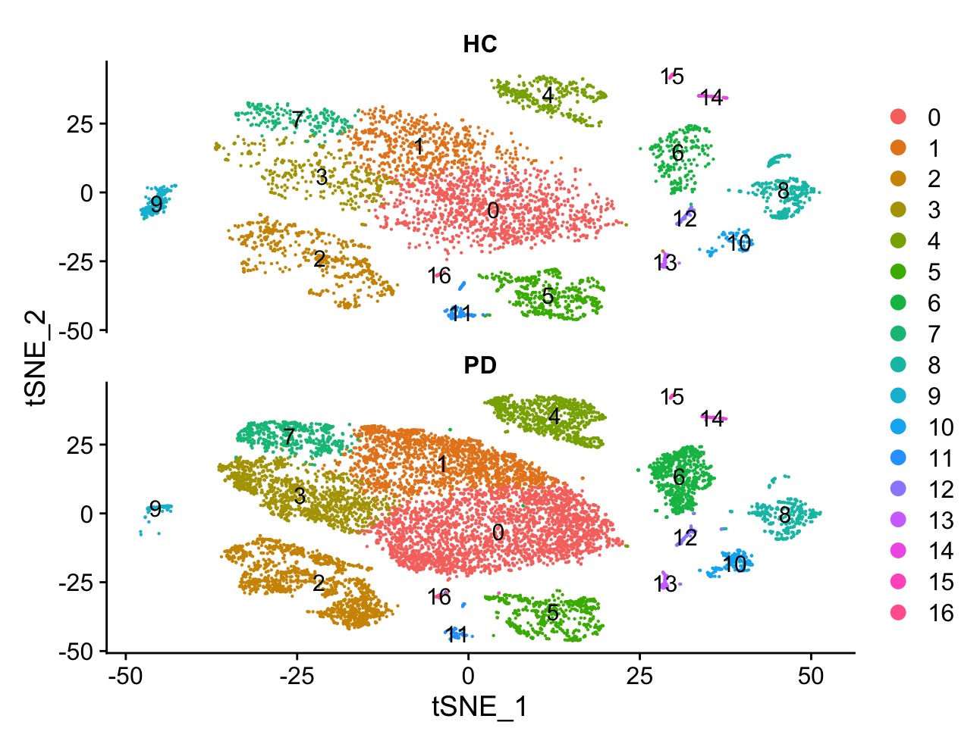

Slide 16
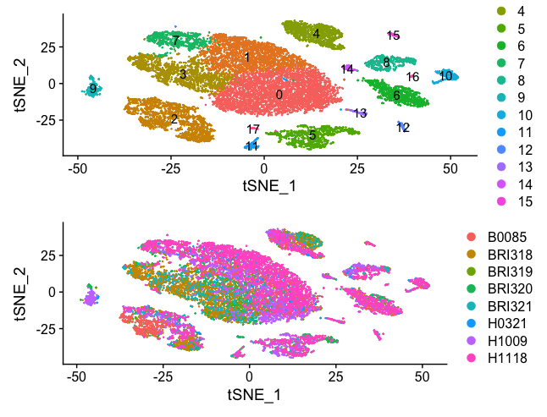

Slide 17
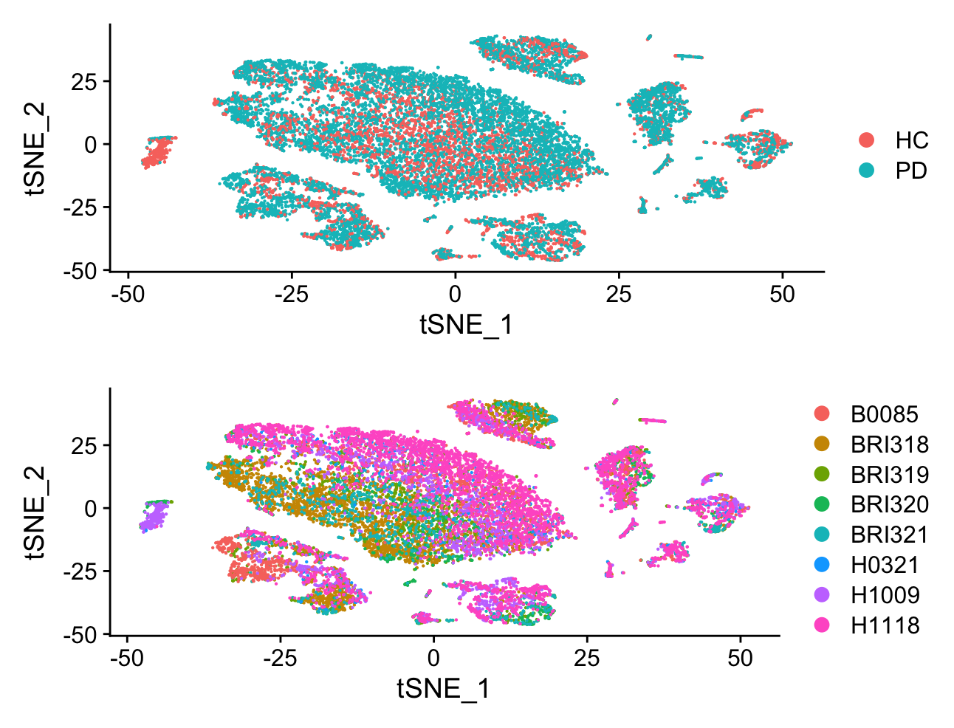

Slide 20
Healthy Samples

Slide 21
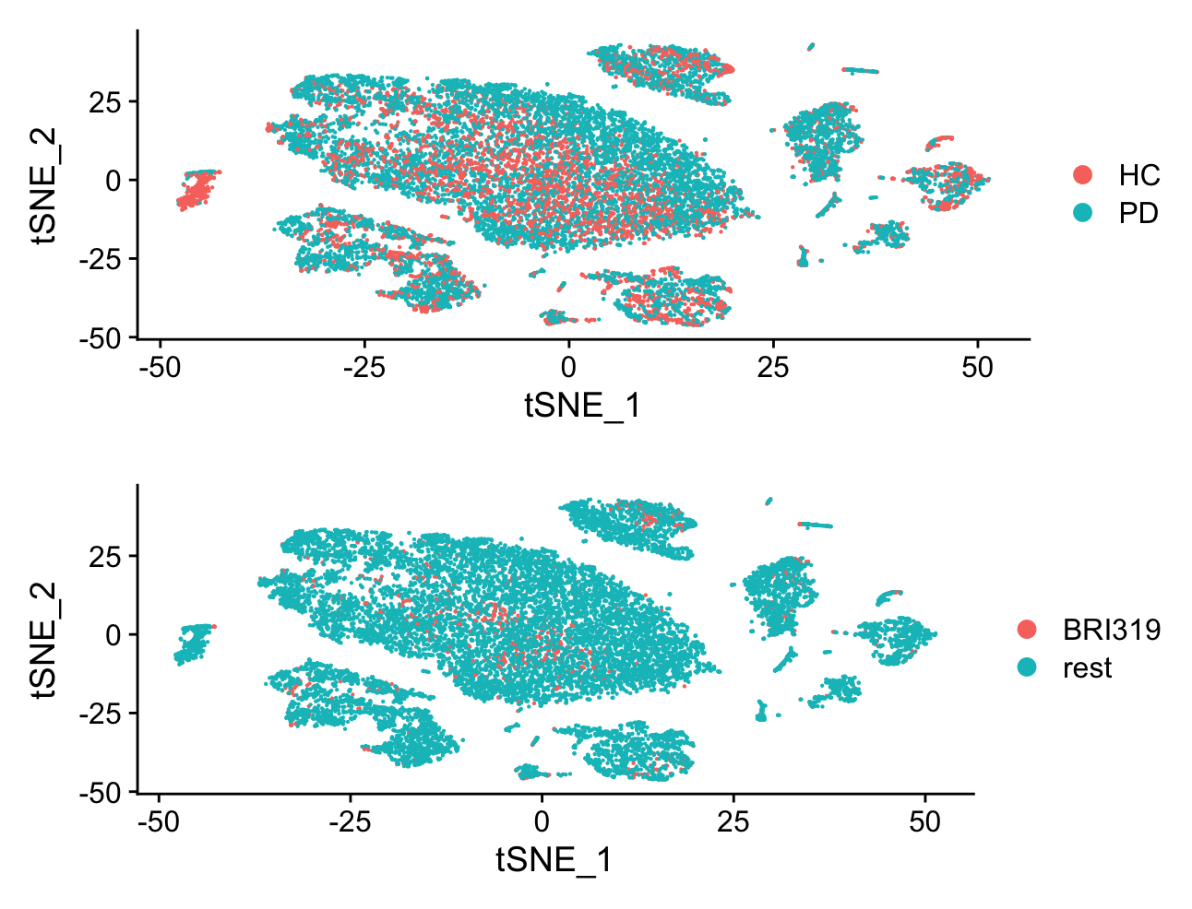

Slide 22
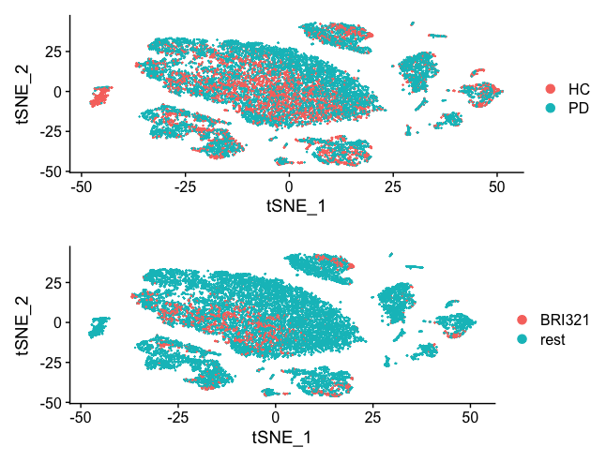

Slide 25
PD Samples

Slide 29
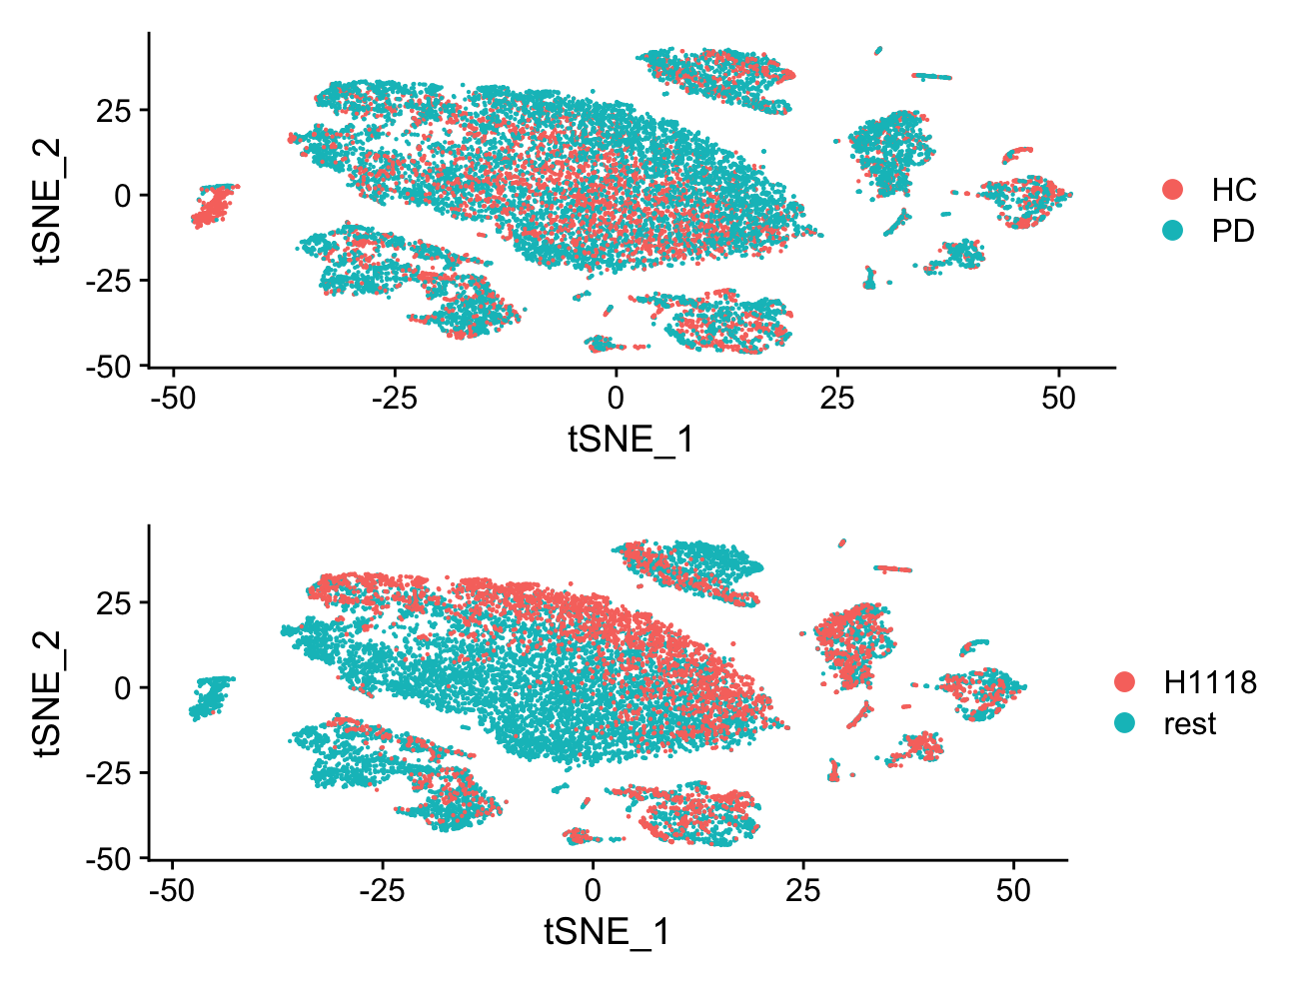

Slide 30
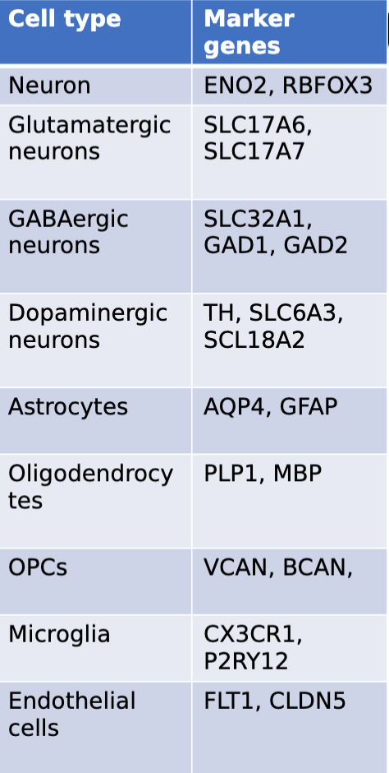

Slide 31
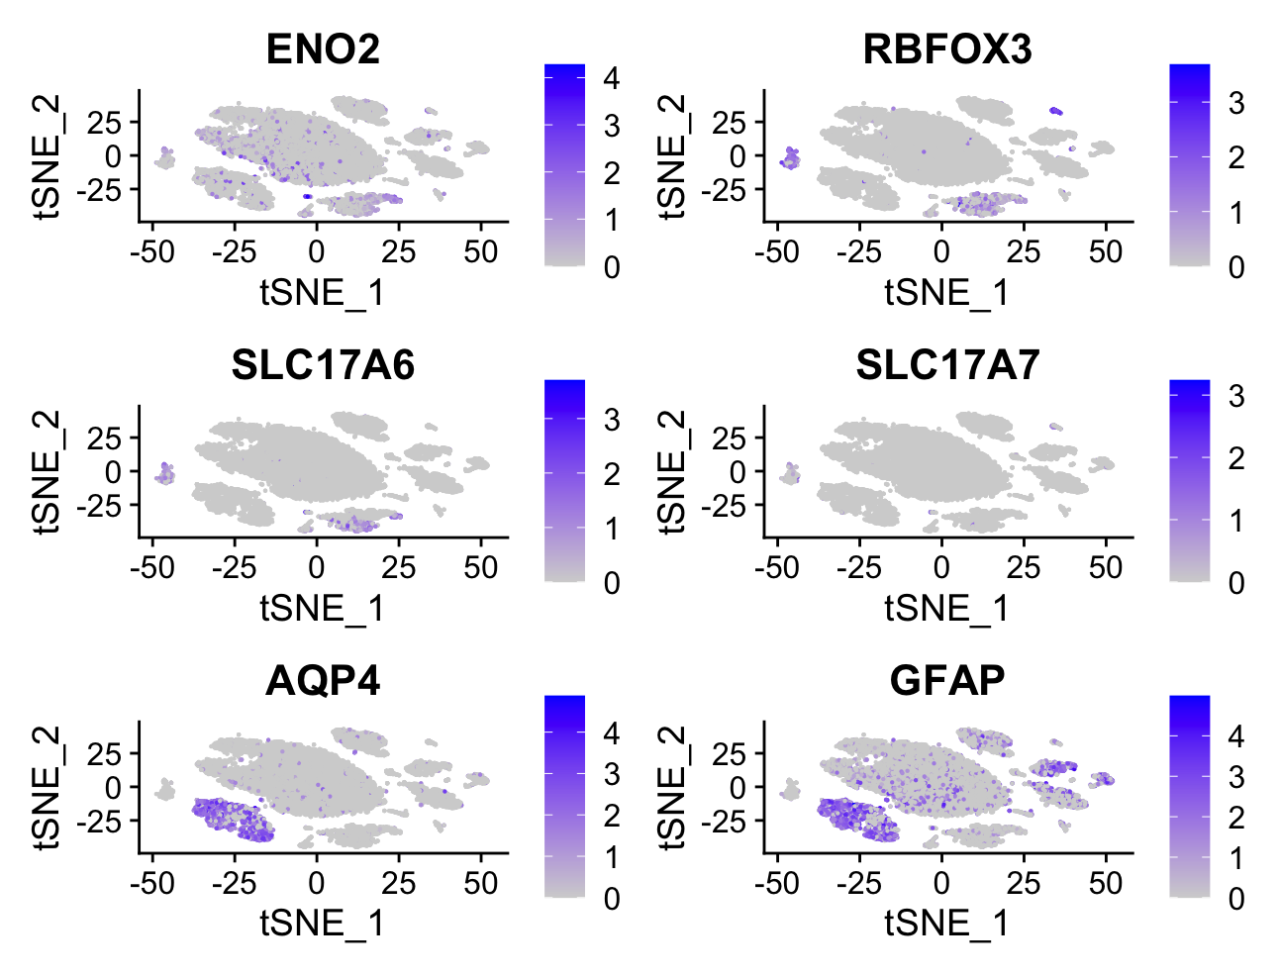

Slide 32
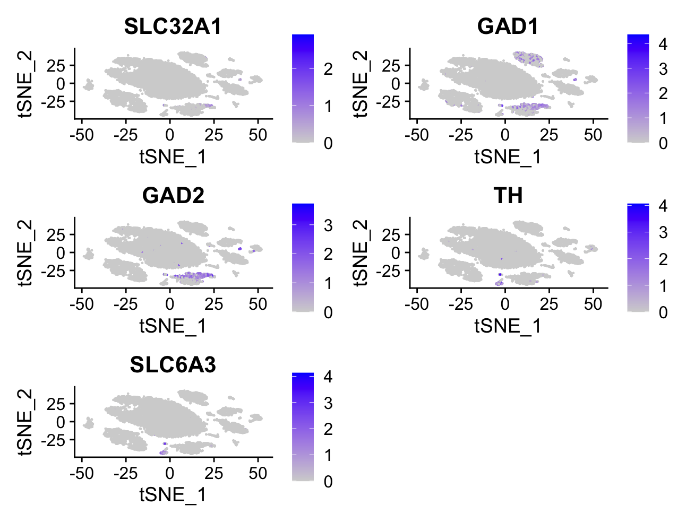

Slide 33
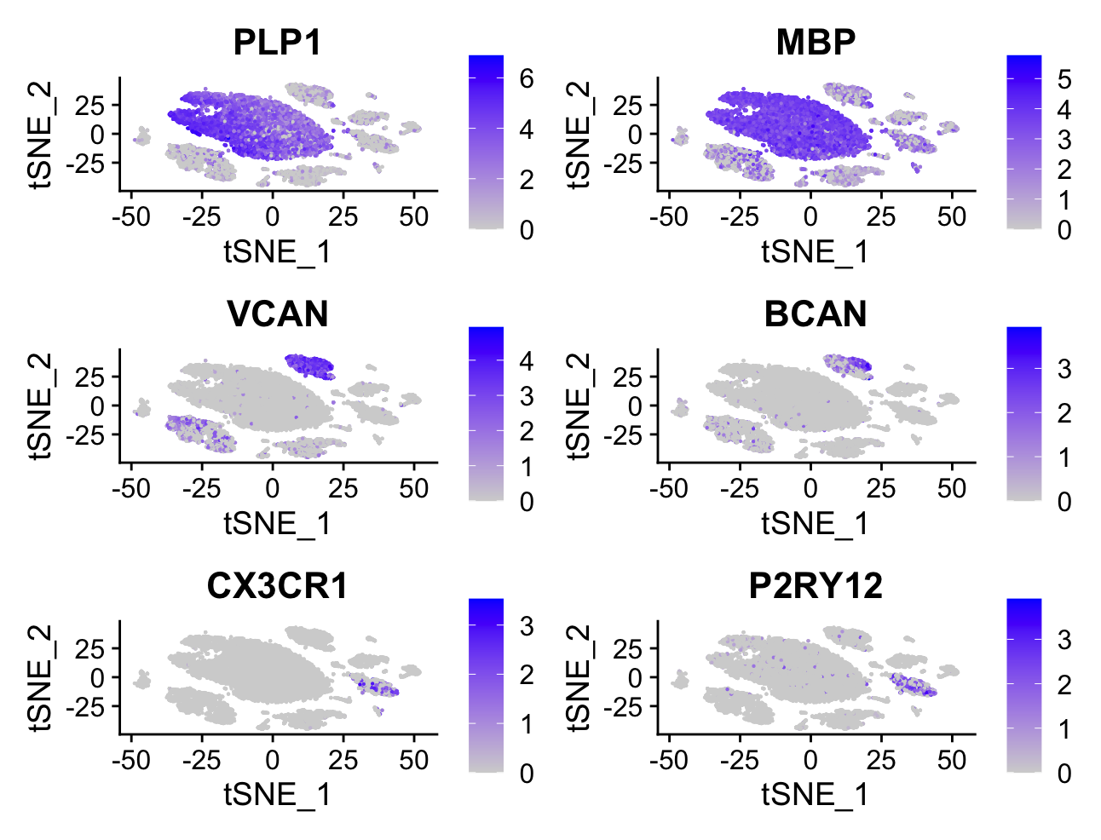

Slide 34
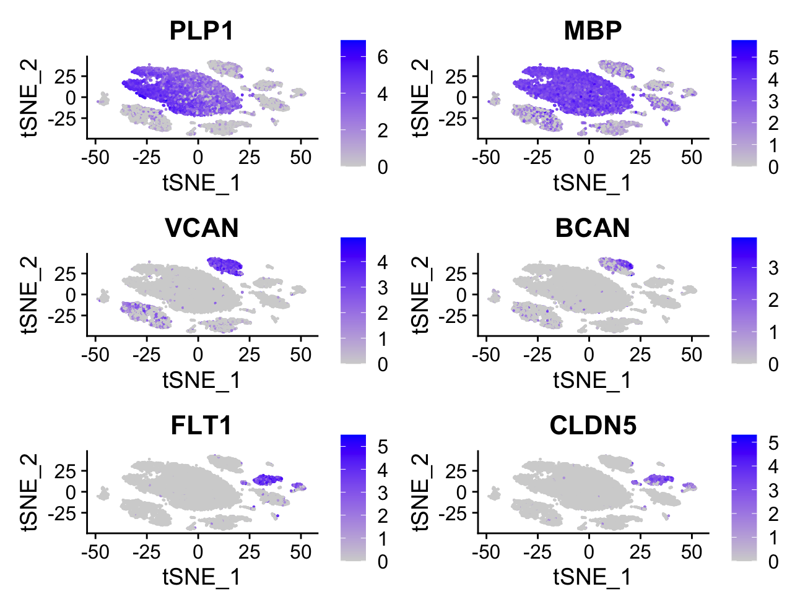

Slide 35
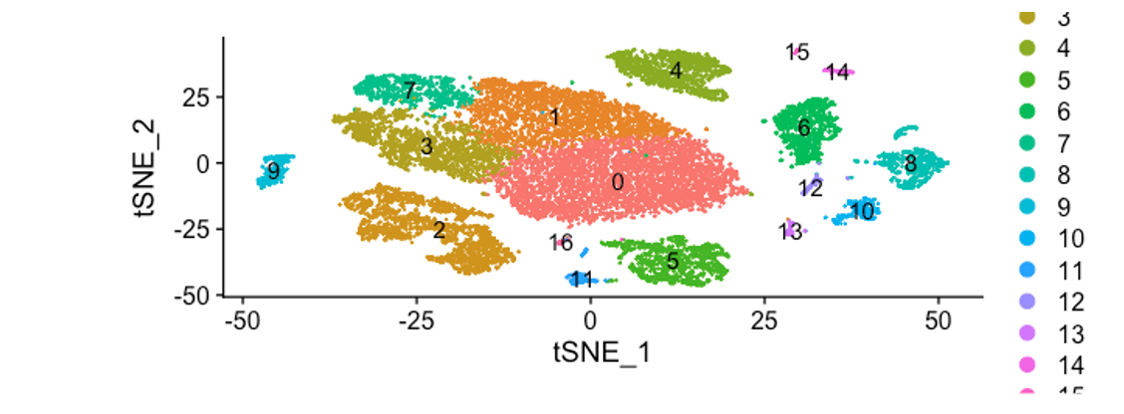

Slide 54
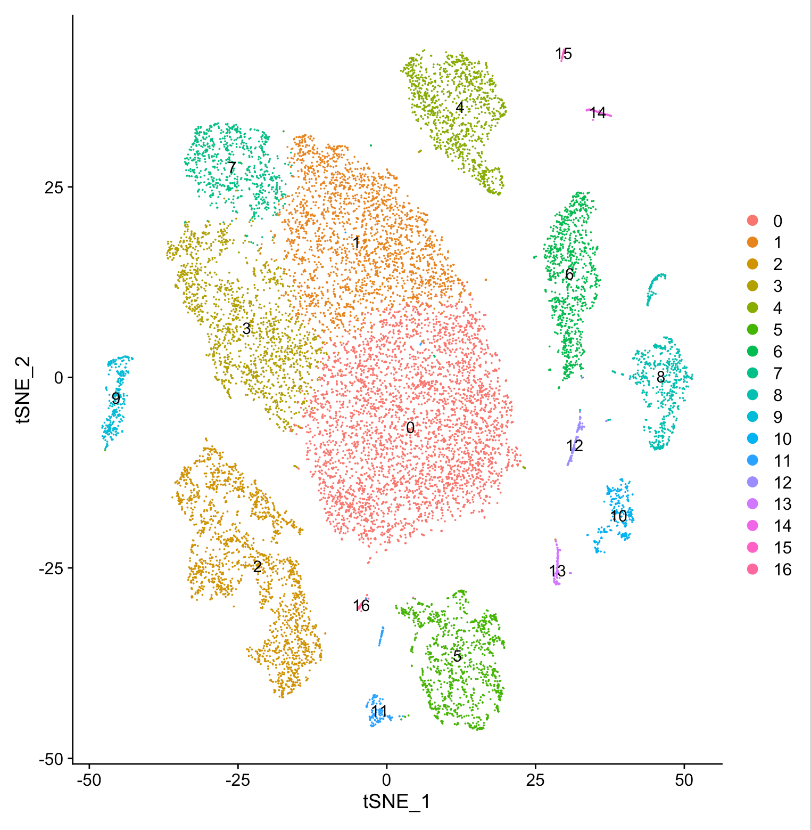

Slide 55
Seurat Clustering Algorithm
Take top 2000 most varying genes
Do PCA and take PCA1-PCA30
Construct a graph with a distance metrics between each cell-pairs,
such as cosine, euclidian distance, neighborhood overlap (Jacard Index), …
4. Community Detection using Waltman 2013 algorithm

Slide 56
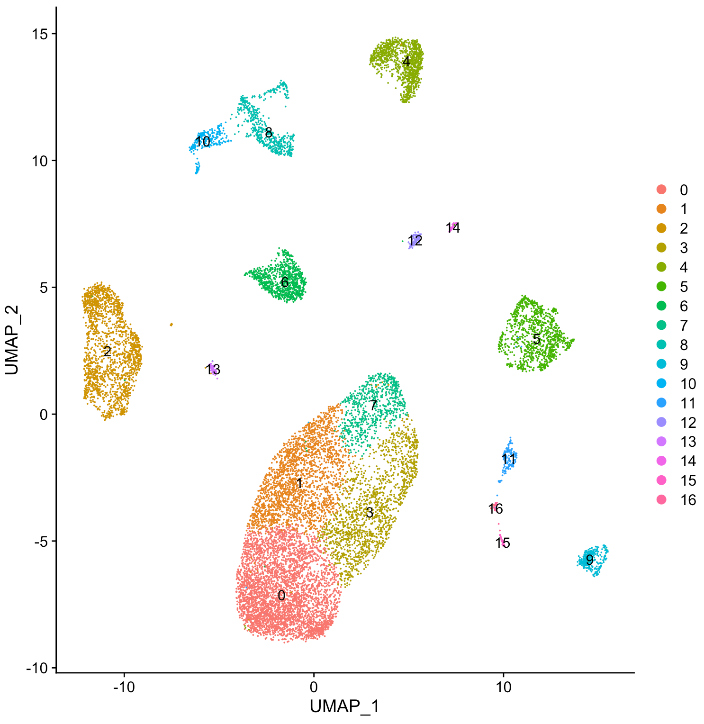

Slide 58
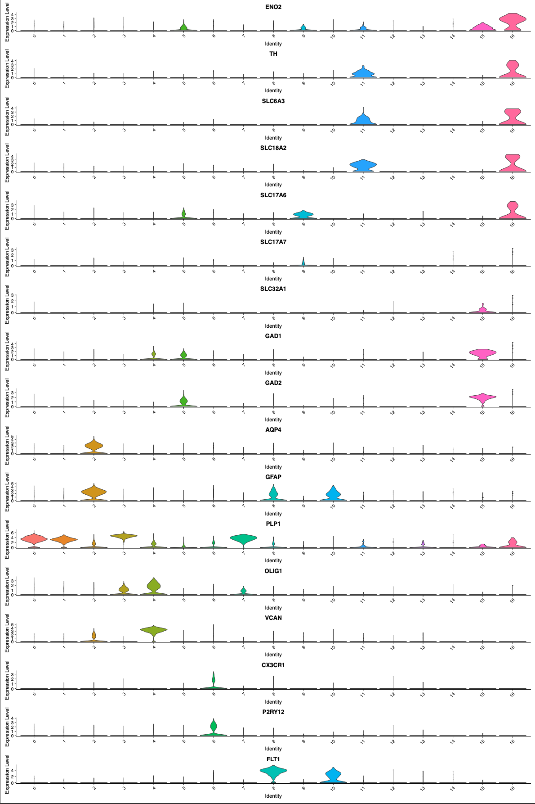

Slide 59
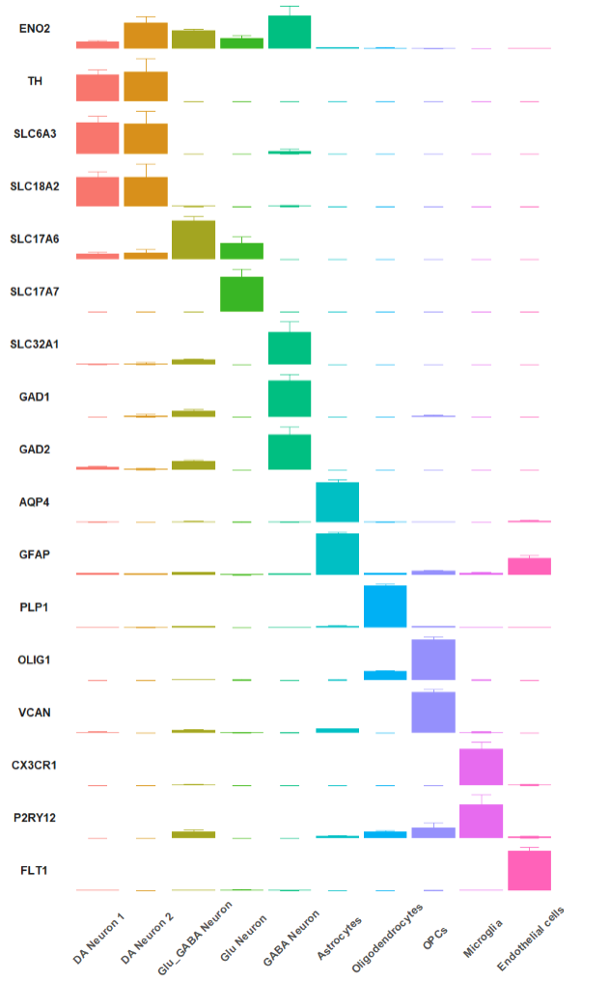

Slide 60
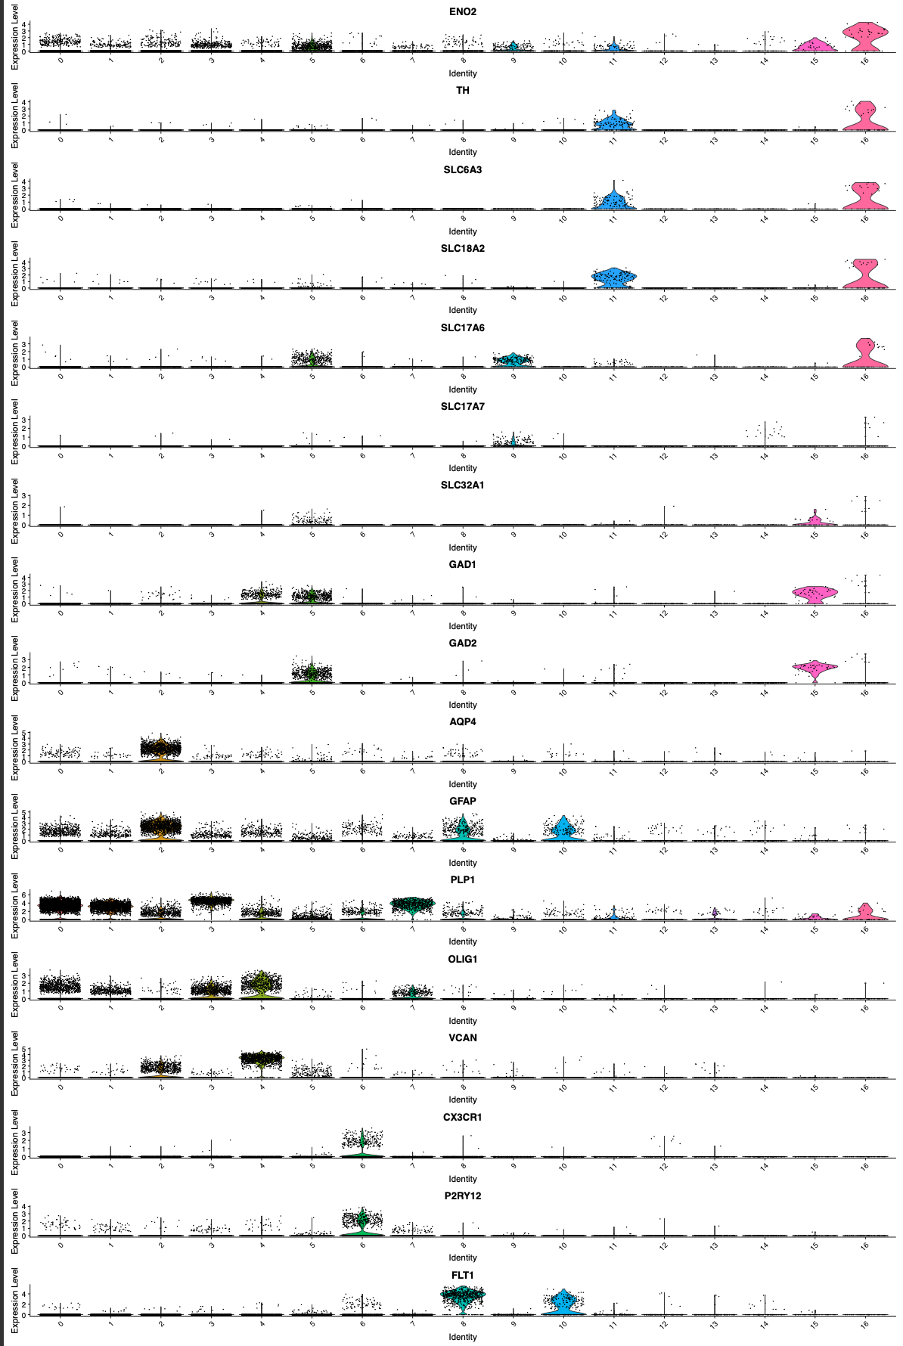

Slide 61
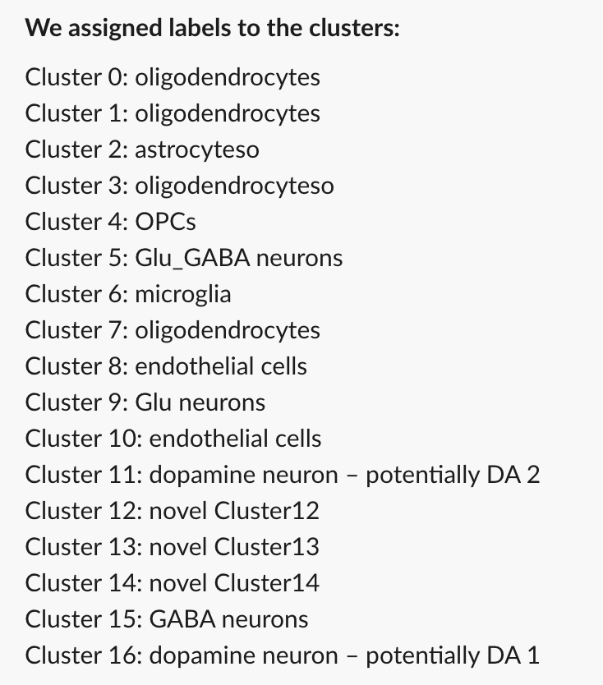

Slide 62
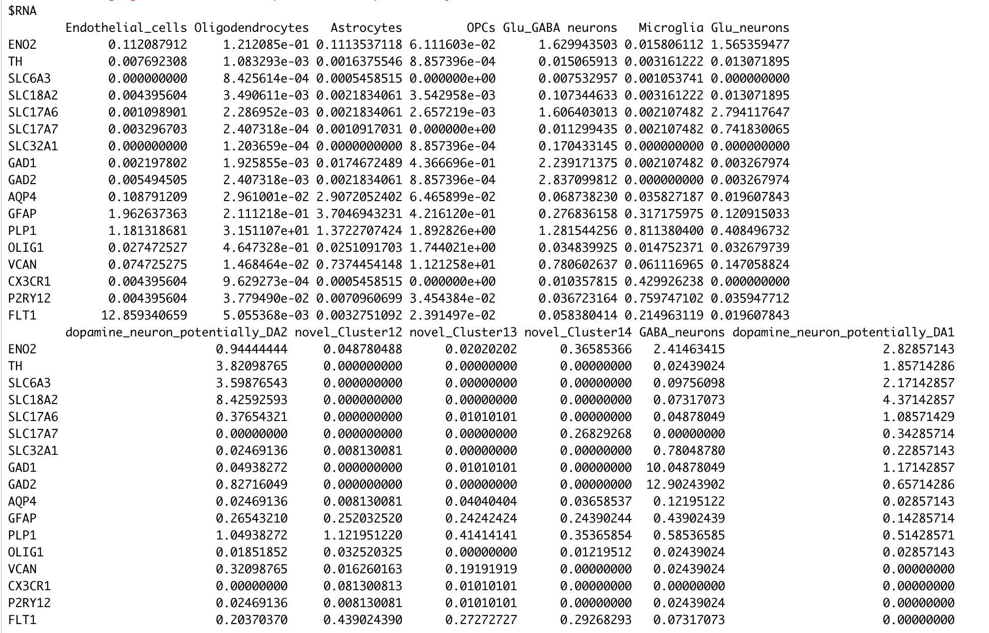

Slide 63
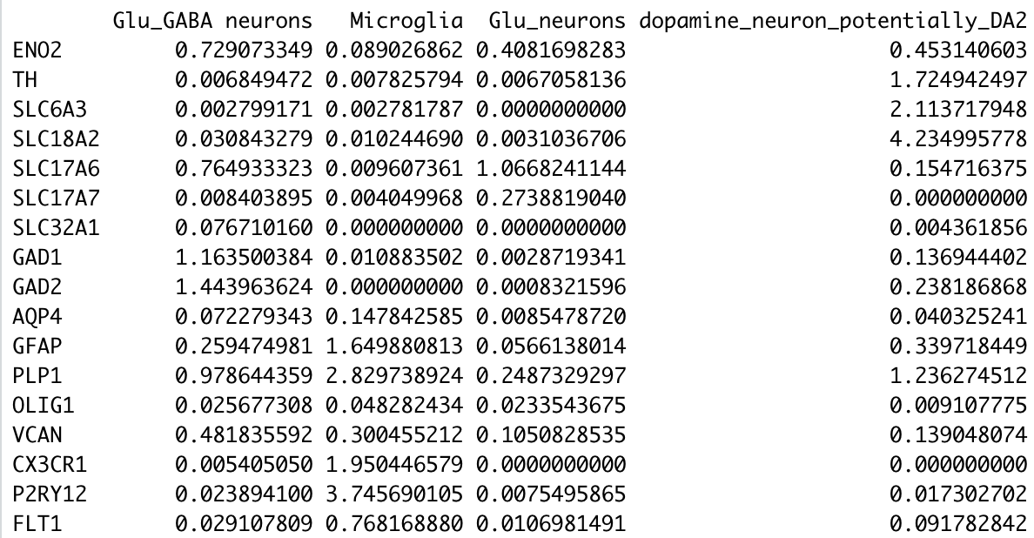
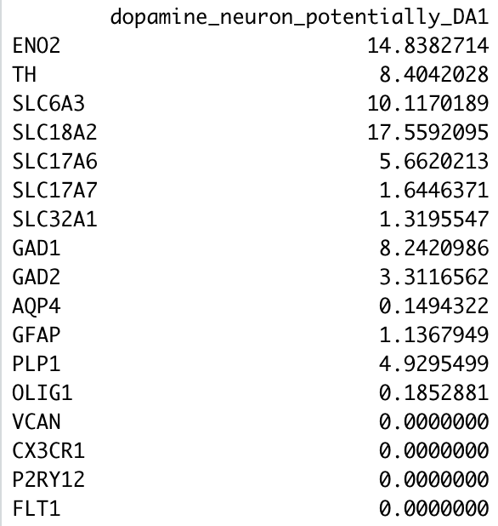

Slide 64
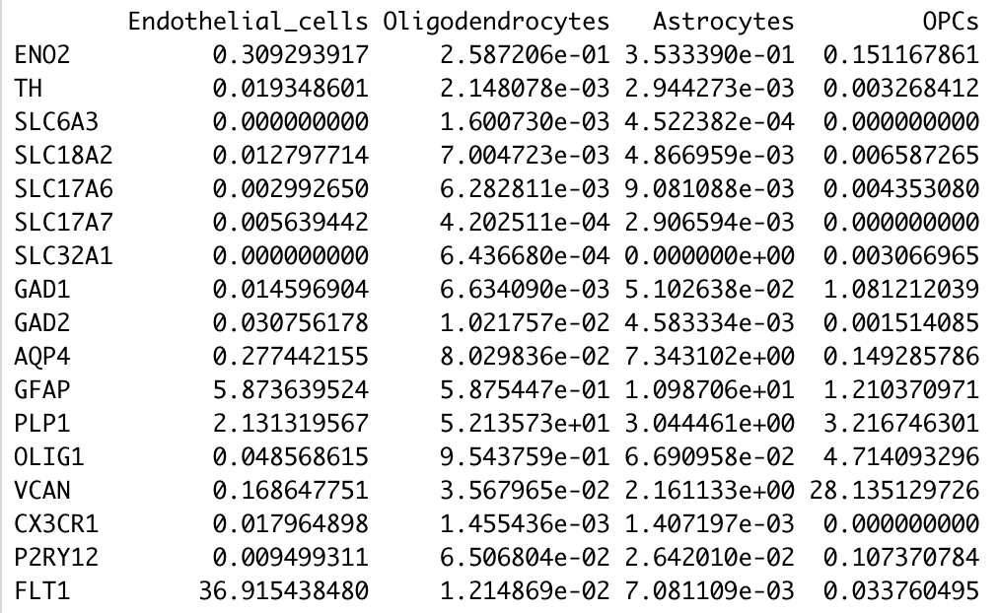

Slide 65
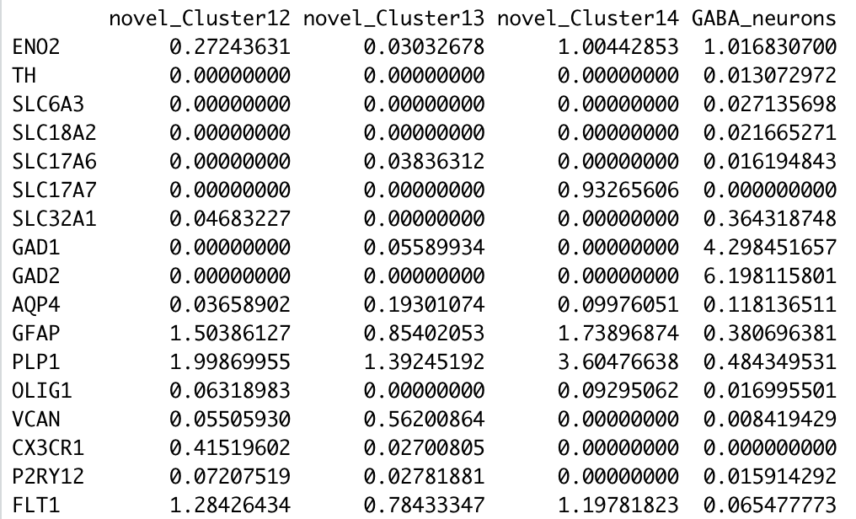

Slide 66
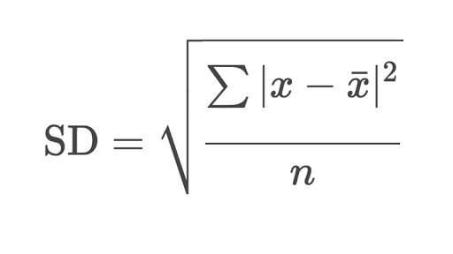

Slide 67
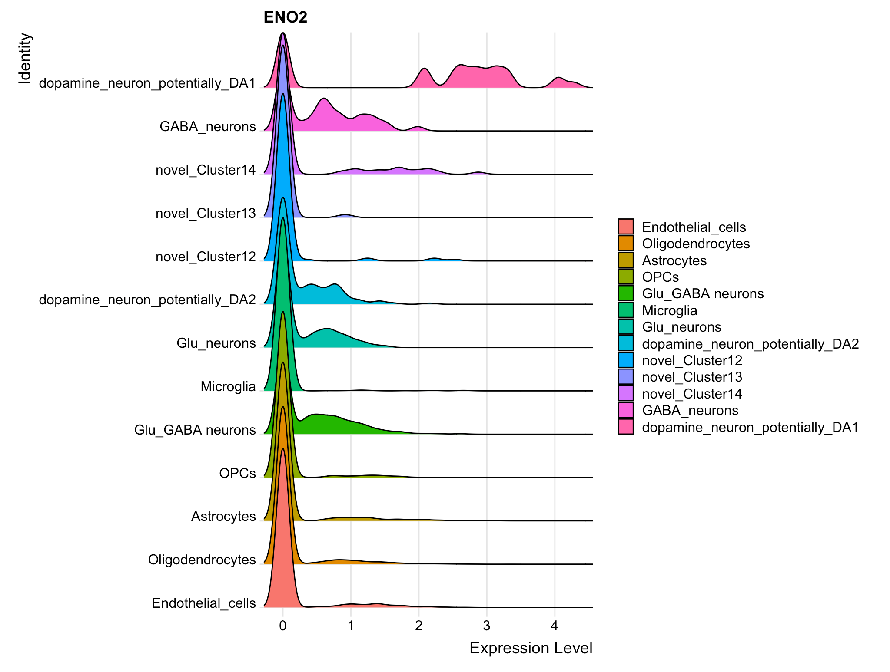

Slide 68
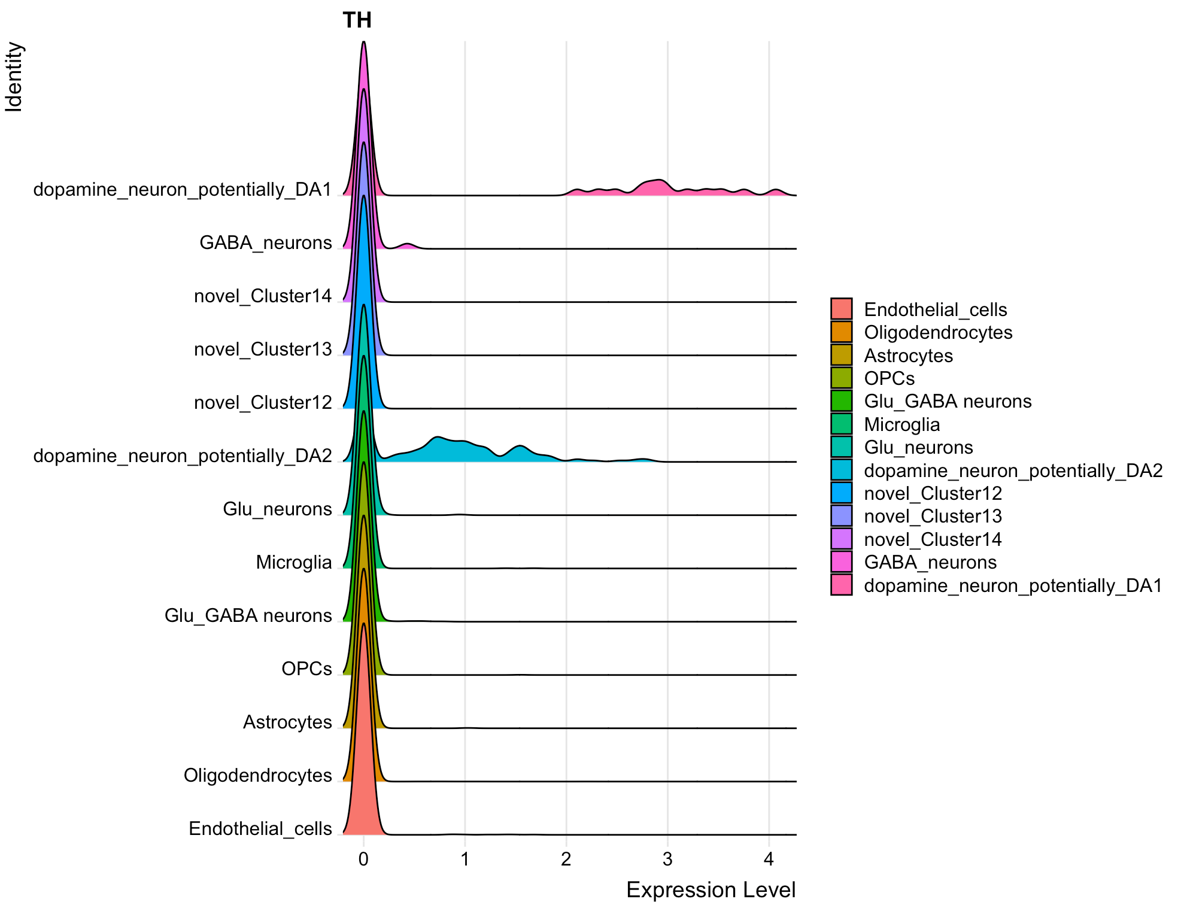

Slide 69
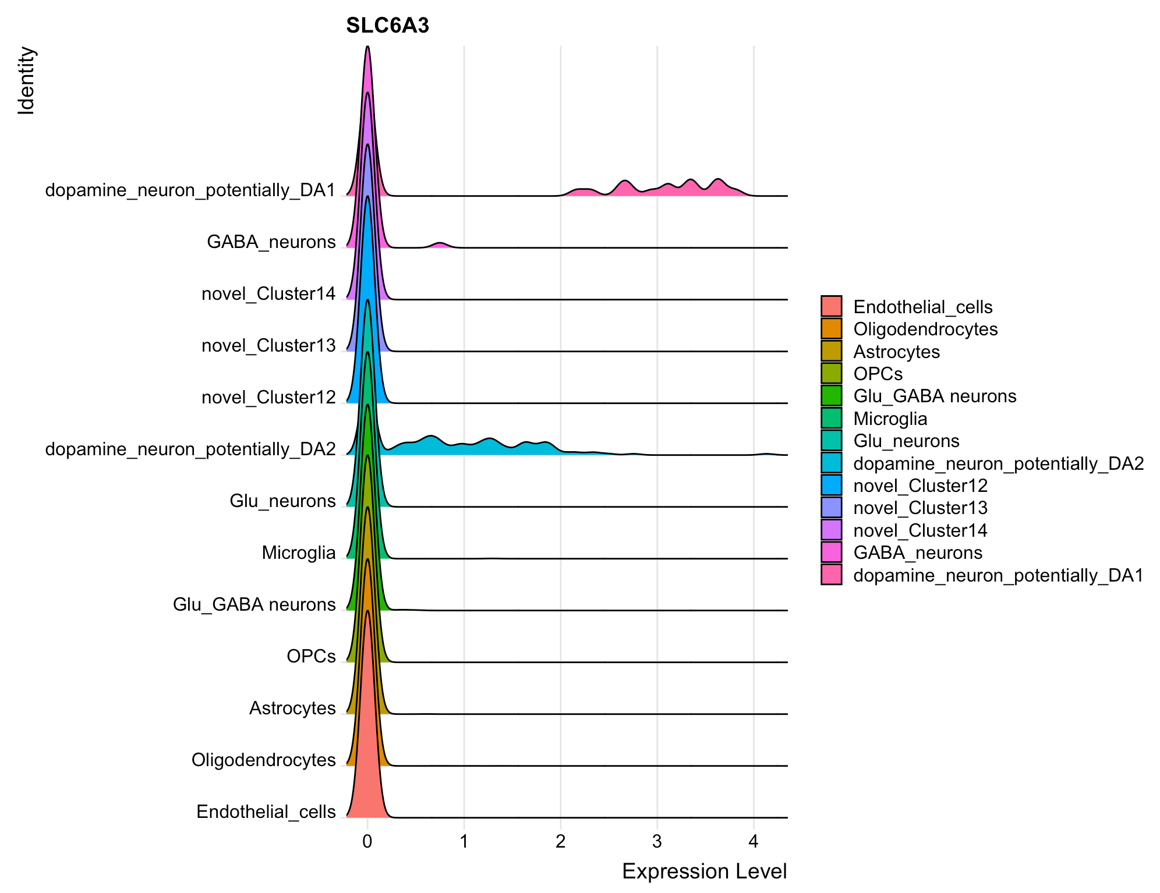

Slide 70
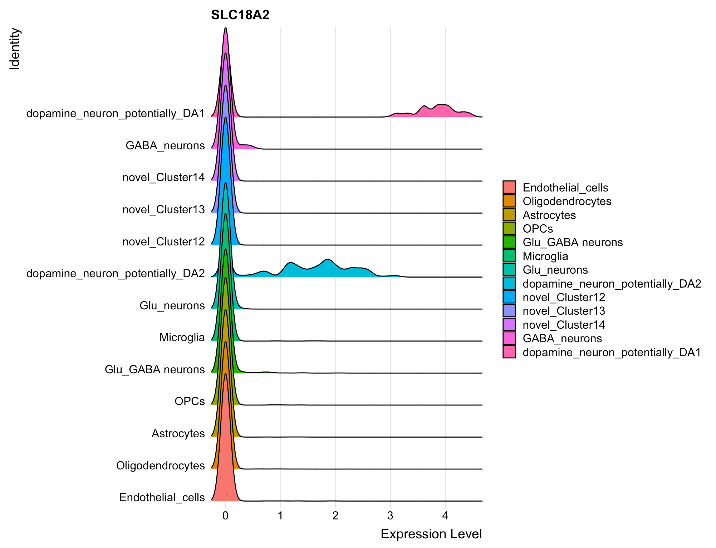

Slide 71
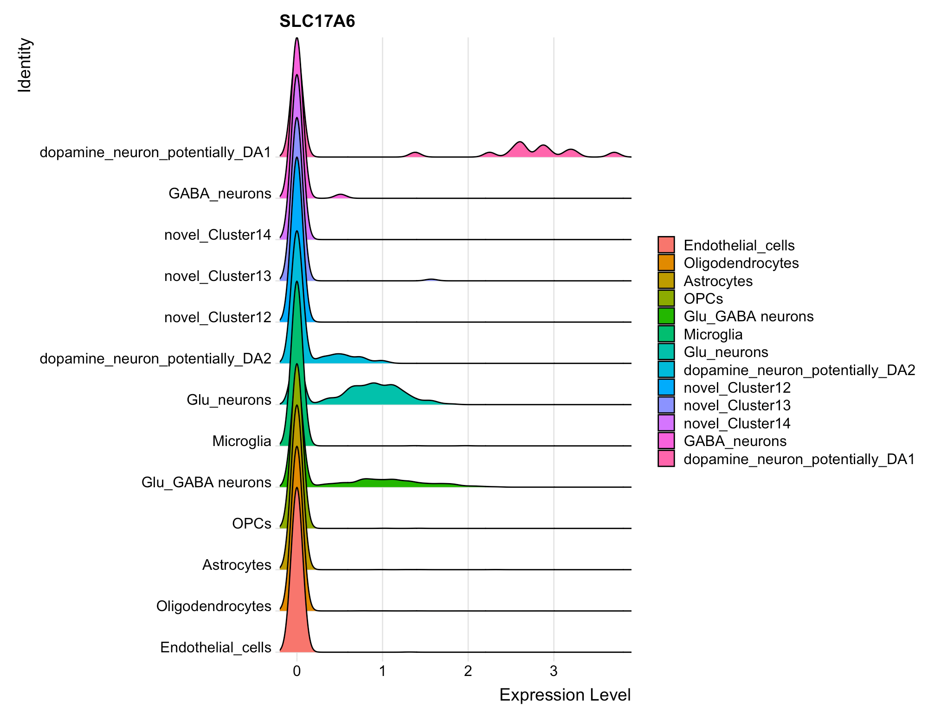

Slide 72
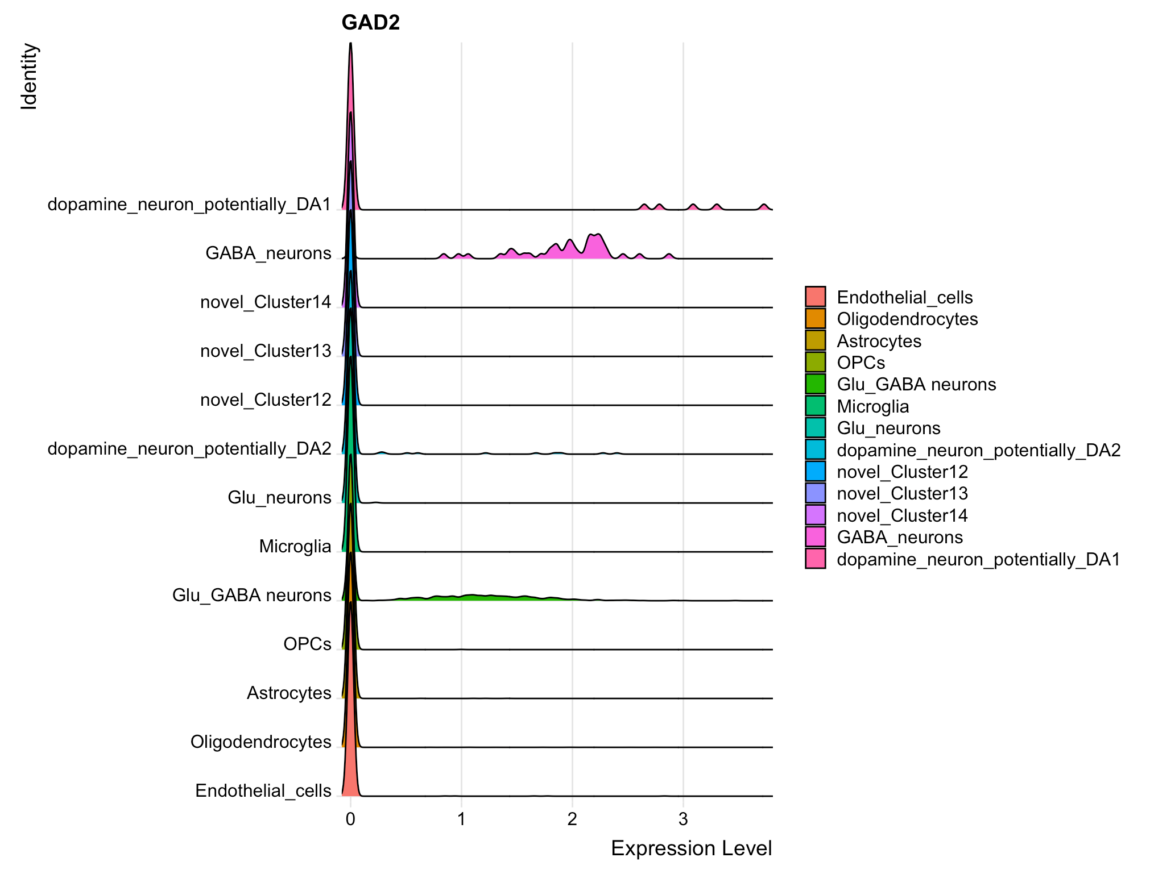

Slide 73
Seurat Clustering Algorithm
Take top 2000 most varying genes
Do PCA and take PCA1-PCA2000 (all PCAs)
Adjust with Harmony Algorithm
Construct a graph with a distance metrics between each cell-pairs,
such as cosine, euclidian distance, neighborhood overlap (Jacard Index), …
5. Community Detection using Waltman 2013 algorithm

Slide 74
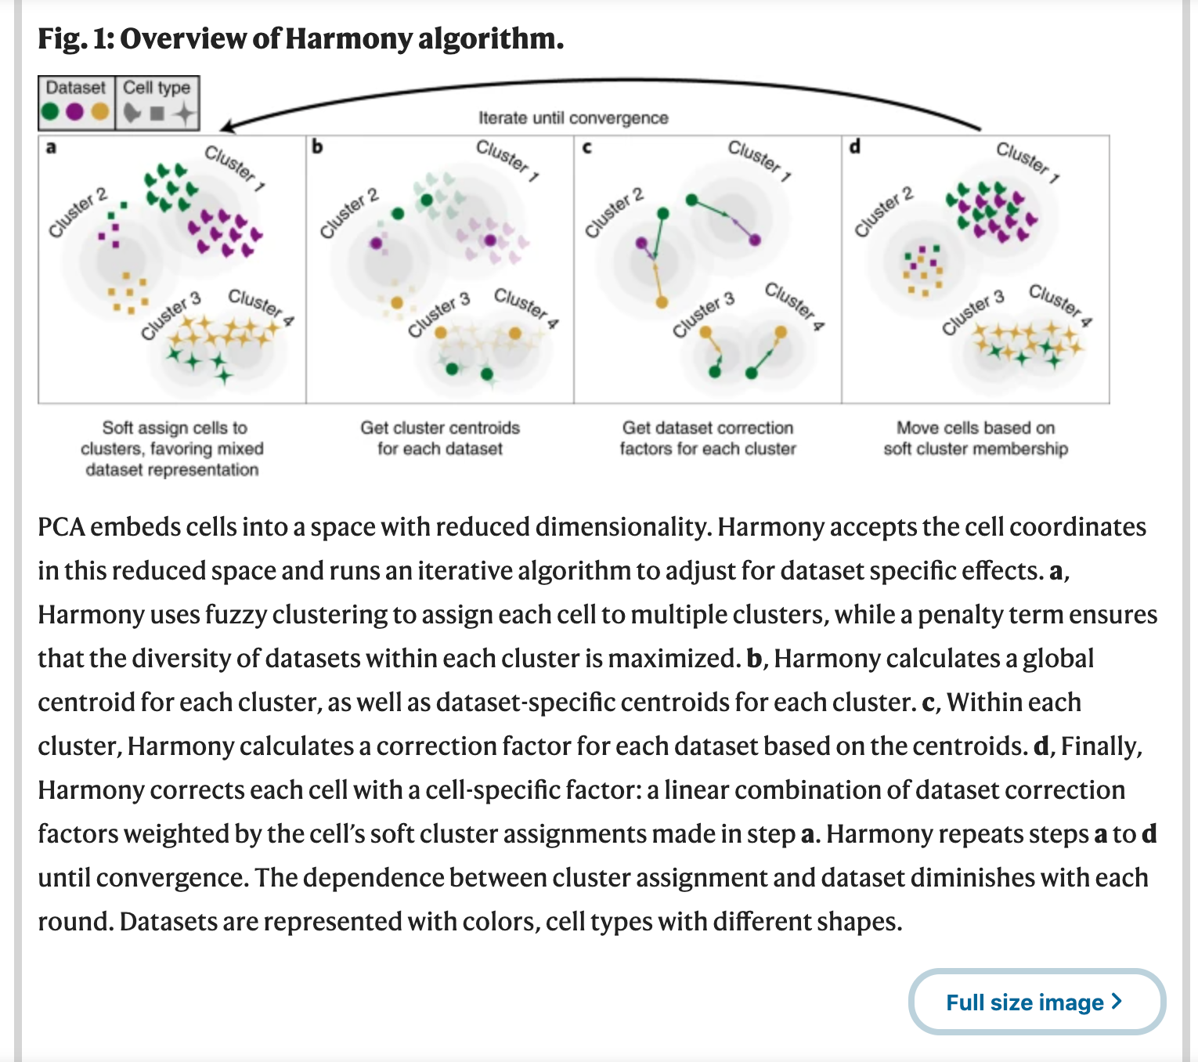

Slide 75
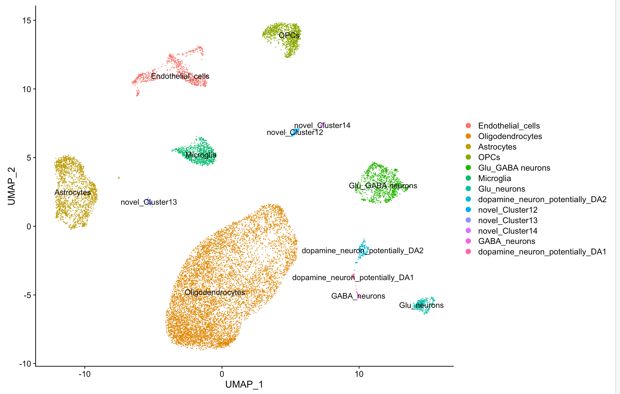

Slide 76
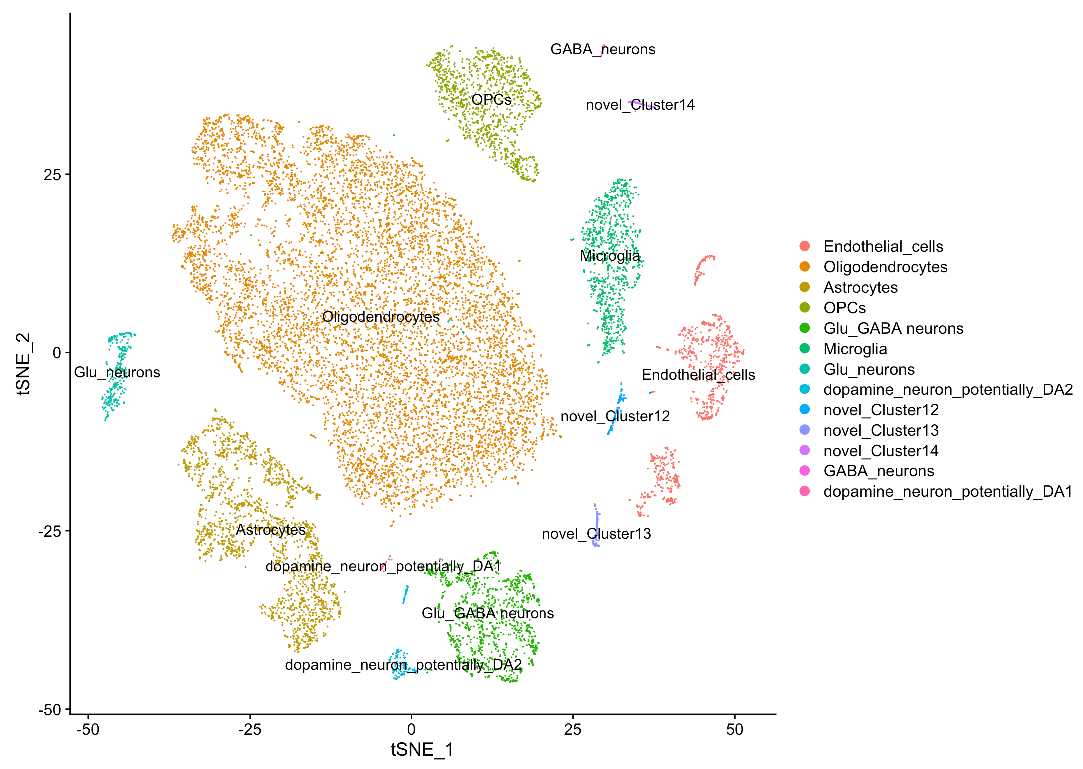

Slide 78
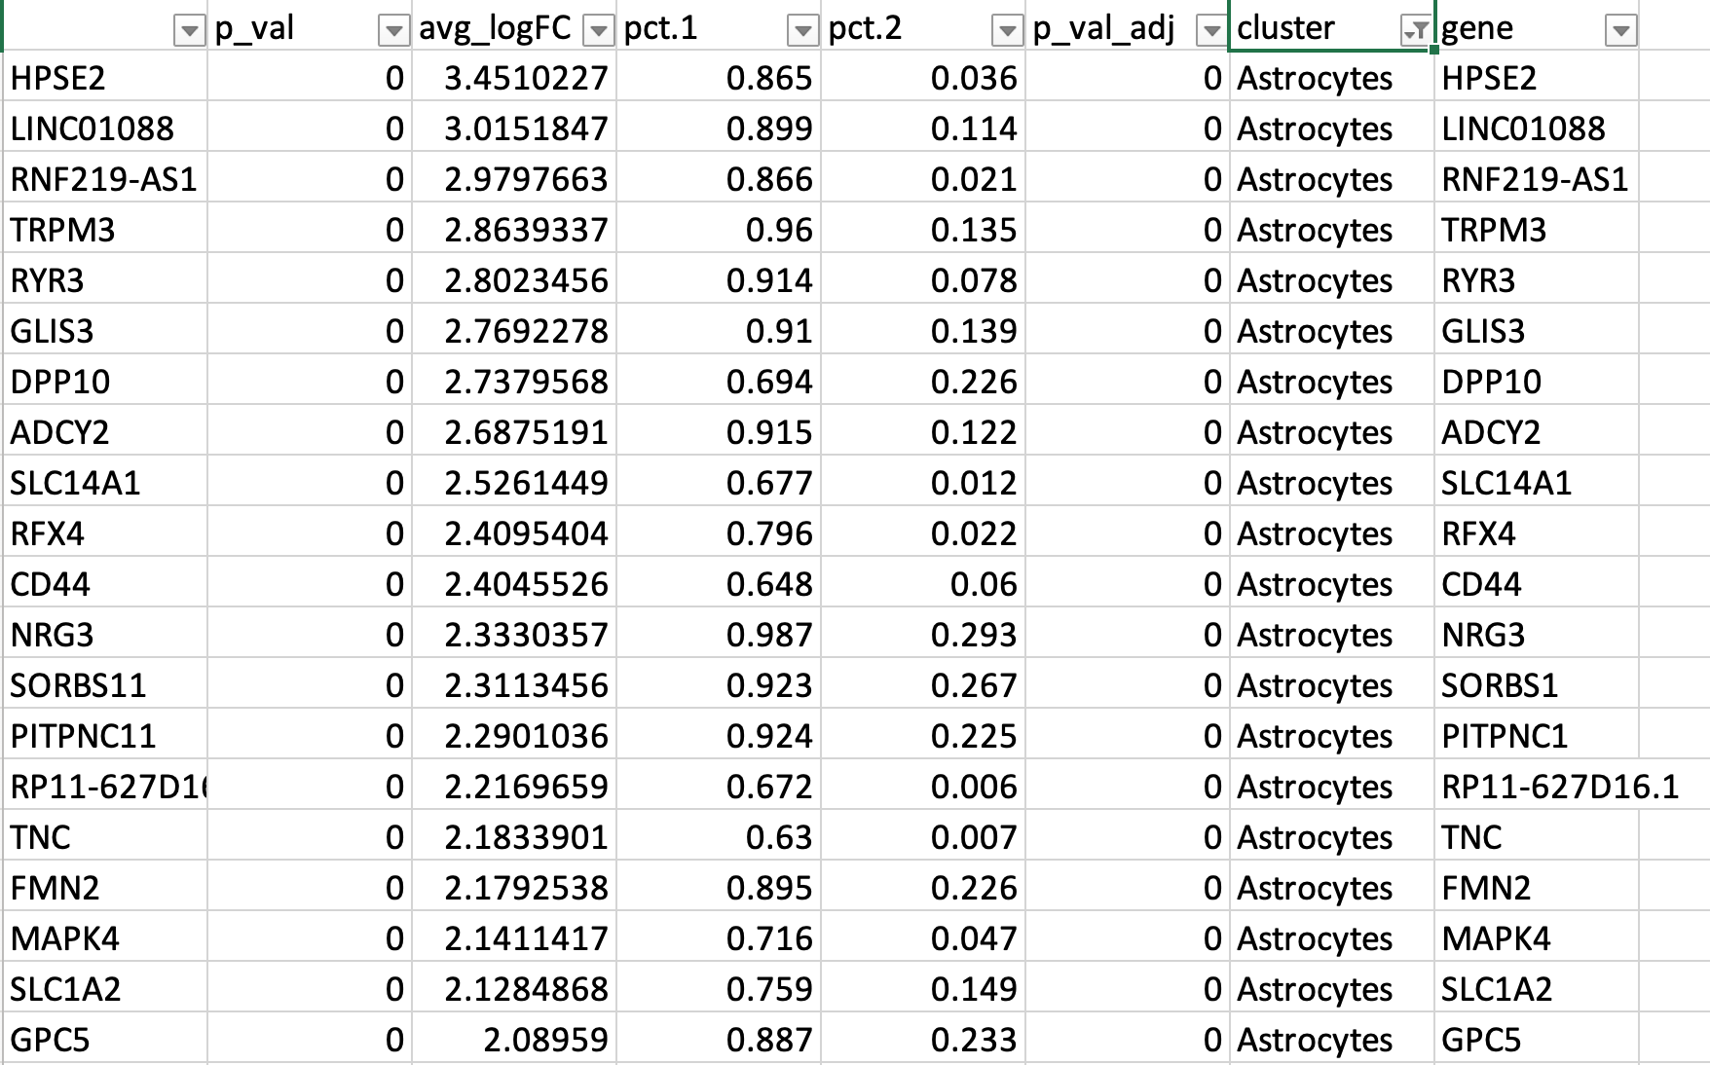

Slide 79
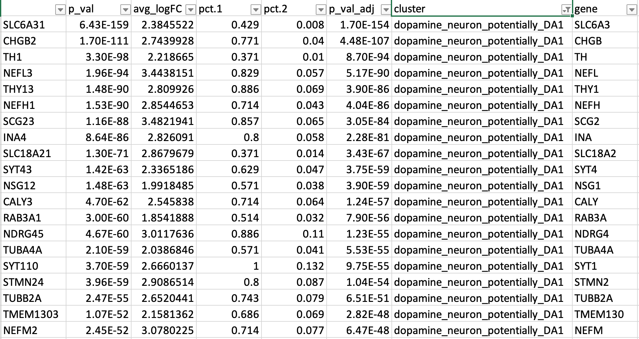

Slide 80
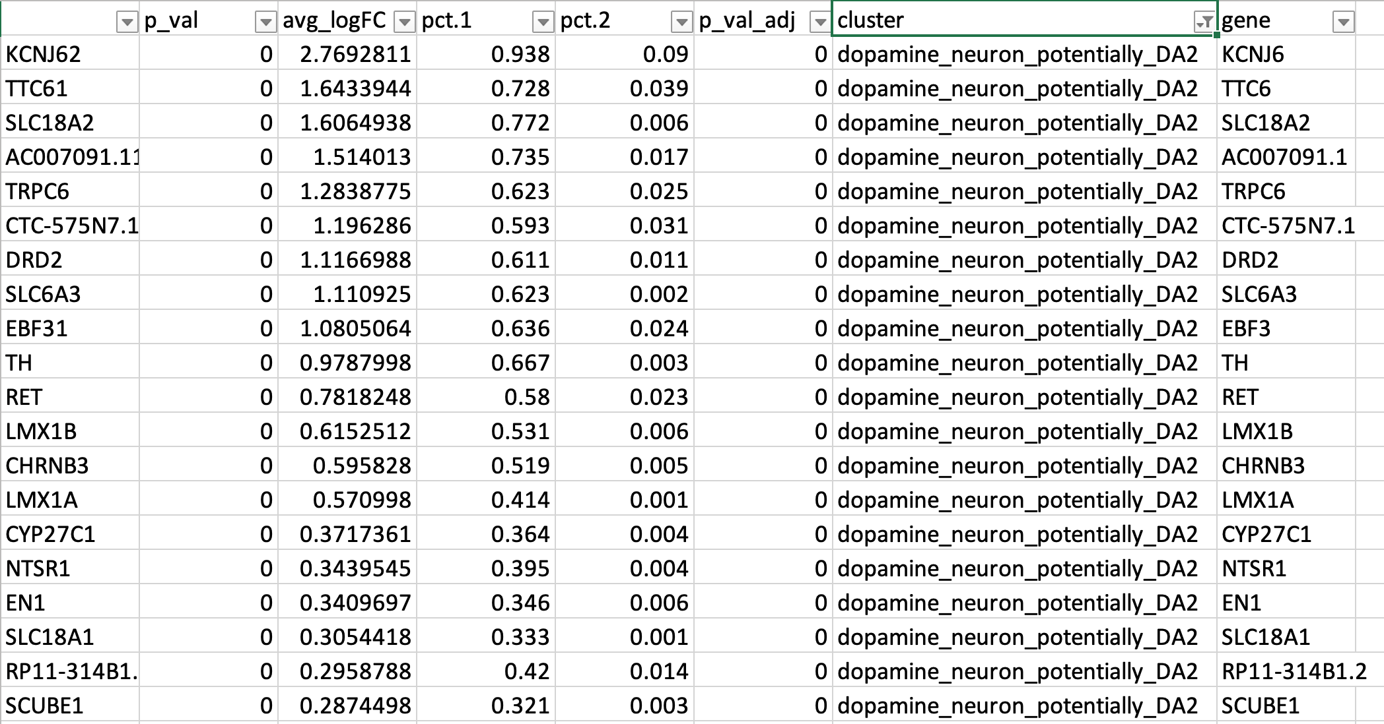

Slide 81
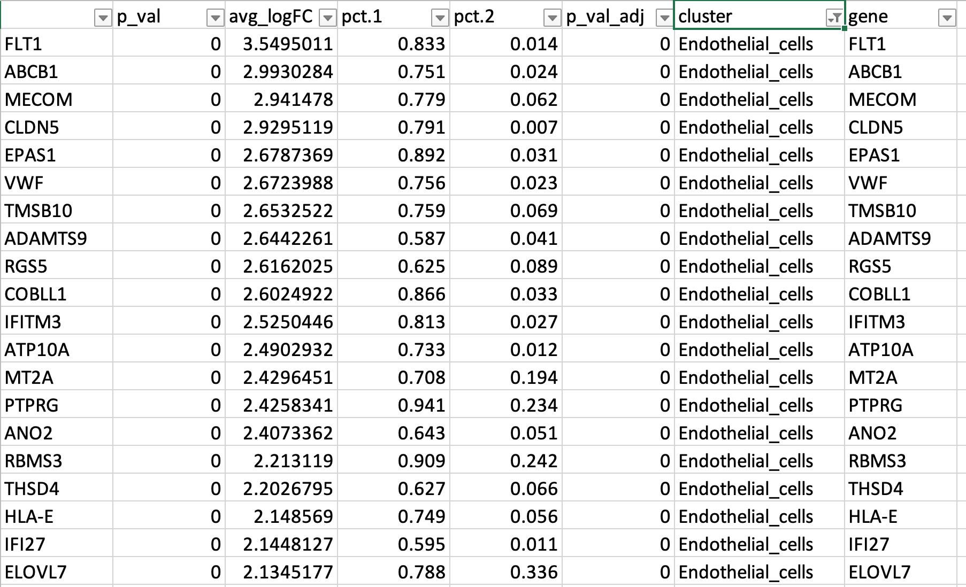

Slide 82
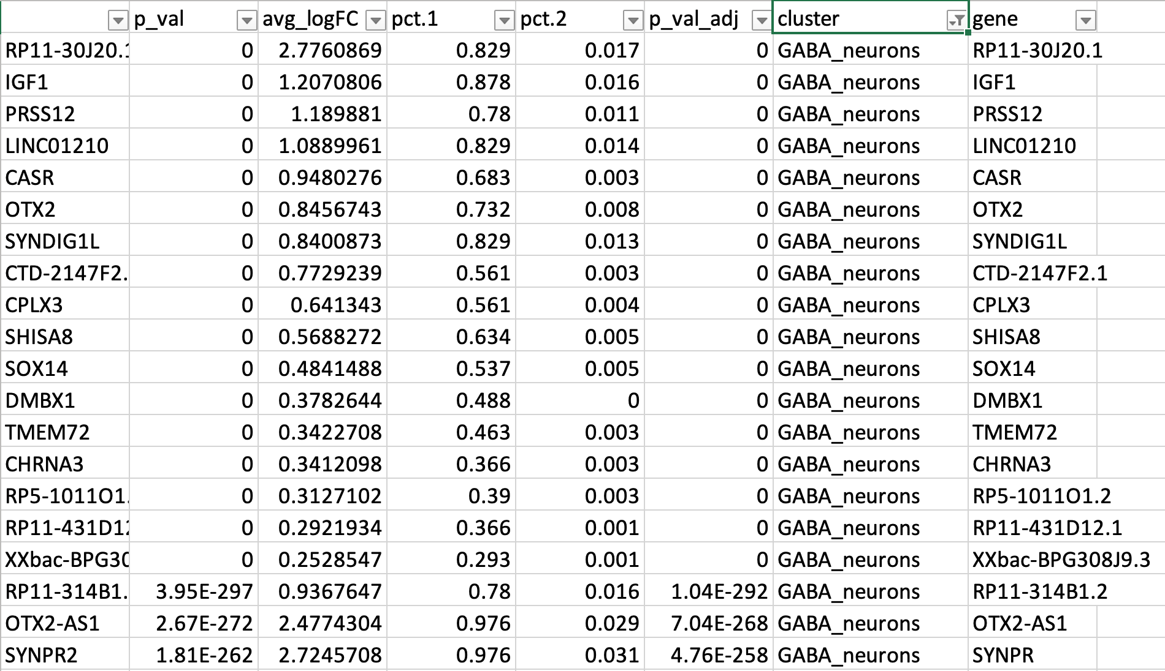

Slide 83


Slide 84


Slide 85


Slide 86


Slide 87


Slide 88


Slide 89


Slide 91


Slide 92


Slide 93


Slide 94


Slide 96
Cell-type Correlations based on the top 10 genes

Slide 97

Astrocytes PD vs HC

Slide 98

Astrocytes PD vs HC

Slide 99
Astrocytes PD vs HC

Slide 100

4 HC samples

Slide 101

4 HC samples

Slide 102
4 HC samples

